Slide 1
Data Structure Analysis and Design

Slide 2
Divide & Conquer

Slide 3
Plan of Lecture
Topics to be covered in Contact Session:
Introduction to the Divide and conquer Strategy
Algorithm and analysis
Merge Sort
Binary Search
Quick Sort
Integer Multiplication

Slide 4
Introduction to Divide and Conquer
What is Divide and Conquer Strategy
Factors affecting:
Design Choice
Number of Sub Problems.
Choice of granularity of Atomic Problems.
Examples:
Merge Sort
Binary Search
Quick Sort
……..

Slide 5
Merge Sort
The merge sort algorithm is defined recursively:
If the list is of size 1:
it is sorted—we are done;
Otherwise:
Divide an unsorted list into two sub-lists,
Sort each sub-list recursively using merge sort,
Merge the two sorted sub-lists into a single sorted list
Question: How quickly can we recombine the two sub-lists into a single sorted list?

Slide 6
Merge Sort
Non In-Place sort (Uses extra space)
2T(n/2) | + | N
Break |  | Merge
15 | 13 | 16 | 3 | 7 | 82 | 8 | 10 | 25

Slide 7
The Algorithm
The algorithm:
Split the list into two approximately equal sub-lists
Recursively call merge sort on both sub lists
Merge the resulting sorted lists
void merge_sort( Type *array, int first, int last )
{
int midpoint = (first + last)/2;
merge_sort( array, first, midpoint );
merge_sort( array, midpoint, last );
merge( array, first, midpoint, last );
}

Slide 8
Run-time Analysis of Merge Sort
Thus, the time required to sort an array of size n > 1 is:
Time required to Sort the first half,
Time required to Sort the second half
Time required to Merge the two lists
That is:
Simplifying this, we have n + n lg(n)
The run time is Θ(n log (n))

Slide 9
Run-time Summary
The following table summarizes the run-times of merge sort
Case | Run Time | Comments
Worst | Θ(n log (n)) | No worst case
Average | Θ(n log (n))
Best | Θ(n log (n)) | No best case

Slide 10
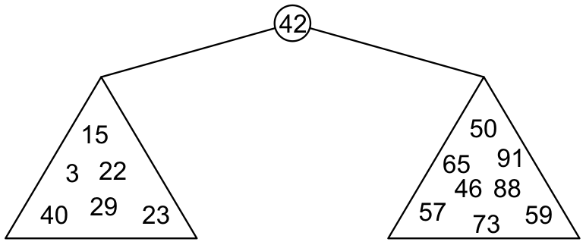
Binary Search Trees
Graphically, we may show the relationship as
Each of the two sub-trees will themselves be binary search trees

Slide 11
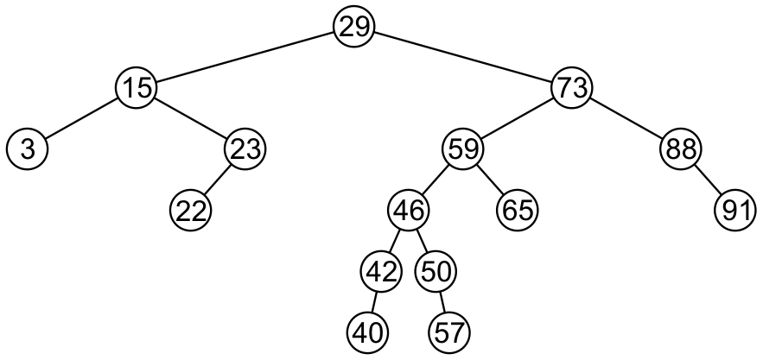
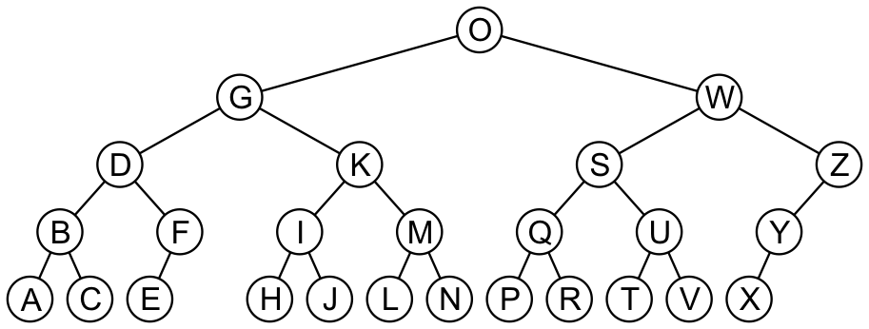
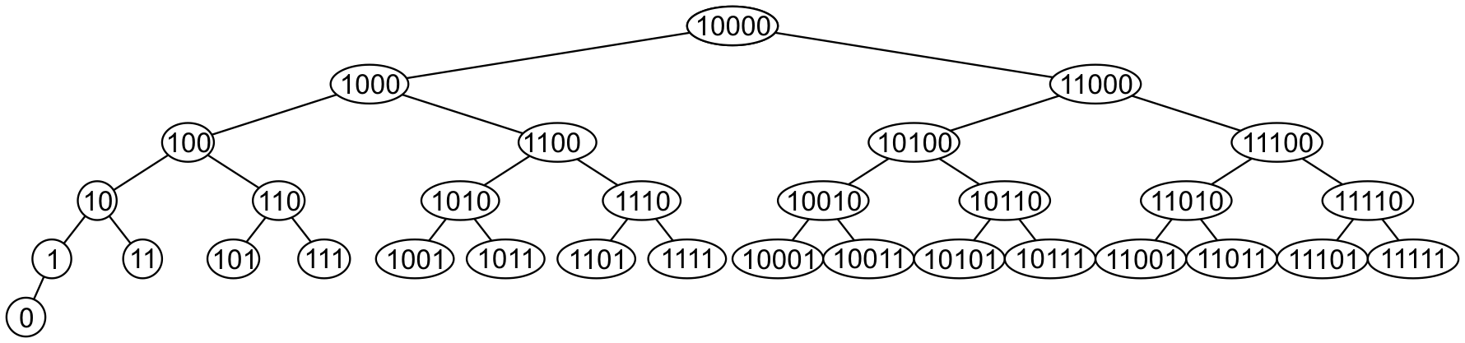
Examples
Here are other examples of binary search trees:

Slide 12
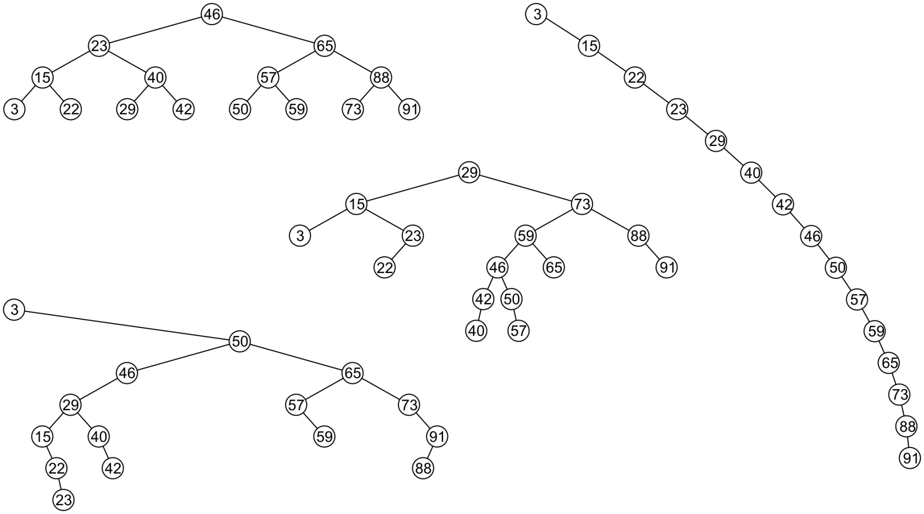
Examples
All these binary search trees store the same data

Slide 13
Quick Sort
A divide-and-conquer algorithm
Divide: partition array into 2 subarrays such that elements in the lower part <= elements in the higher part
Conquer: recursively sort the 2 subarrays
Combine: trivial since sorting is done in-place

Slide 14
Quick Sort
Inpalce sort
Average case O(n log n)
Worst case O(n²)
Partition of set in two halves
Best case :-> in two equal half
Worst case :->
2T(n/2) | + | n
Partition |  | Merge
T(1) | + | T(n-1) | + | n
Partition |  |  |  | Merge

Slide 15
Partitioning
Linear time partitioning procedure
15 | 13 | 16 | 3 | 7 | 82 | 8 | 10

Slide 16
Integer Multiplication
For multiplying big integers, which cannot be handled directly by the arithmetic unit of a single processor.
Data security (big integers are used in encryption schemes)
For integer multiplication, the number of bits has to be an integral multiple of 2.
If not, ZERO’s are added to it.

Slide 17
Decimal Number multiplication
9846*4679
Time complexity is O(n²)
 |  |  |  | 9 | 8 | 4 | 6
 |  |  | * | 4 | 6 | 7 | 9
 |  |  | 8 | 8 | 6 | 1 | 4
 |  | 6 | 8 | 9 | 2 | 2 | X
 | 5 | 9 | 0 | 7 | 6 | X | X
3 | 9 | 3 | 8 | 4 | X | X | X
4 | 6 | 0 | 6 | 9 | 4 | 3 | 4

Slide 18
Binary Number multiplication
11101010*10111001
Time complexity is O(n²)
 | 1 | 10 | 10 | 11 | 10 | 10 | 10 | 10 | 1 | 0 | 0 | 0 | 0 | 0
 |  |  |  |  |  |  |  | 1 | 1 | 1 | 0 | 1 | 0 | 1 | 0
 |  |  |  |  |  |  | * | 1 | 0 | 1 | 1 | 1 | 0 | 0 | 1
 |  |  |  |  |  |  |  | 1 | 1 | 1 | 0 | 1 | 0 | 1 | 0
 |  |  |  |  | 1 | 1 | 1 | 0 | 1 | 0 | 1 | 0 | X | X | X
 |  |  |  | 1 | 1 | 1 | 0 | 1 | 0 | 1 | 0 | X | X | X | X
 |  |  | 1 | 1 | 1 | 0 | 1 | 0 | 1 | 0 | X | X | X | X | X
 | 1 | 1 | 1 | 0 | 1 | 0 | 1 | 0 | X | X | X | X | X | X | X
1 | 0 | 1 | 0 | 1 | 0 | 0 | 1 | 0 | 0 | 0 | 1 | 1 | 0 | 1 | 0

Slide 19
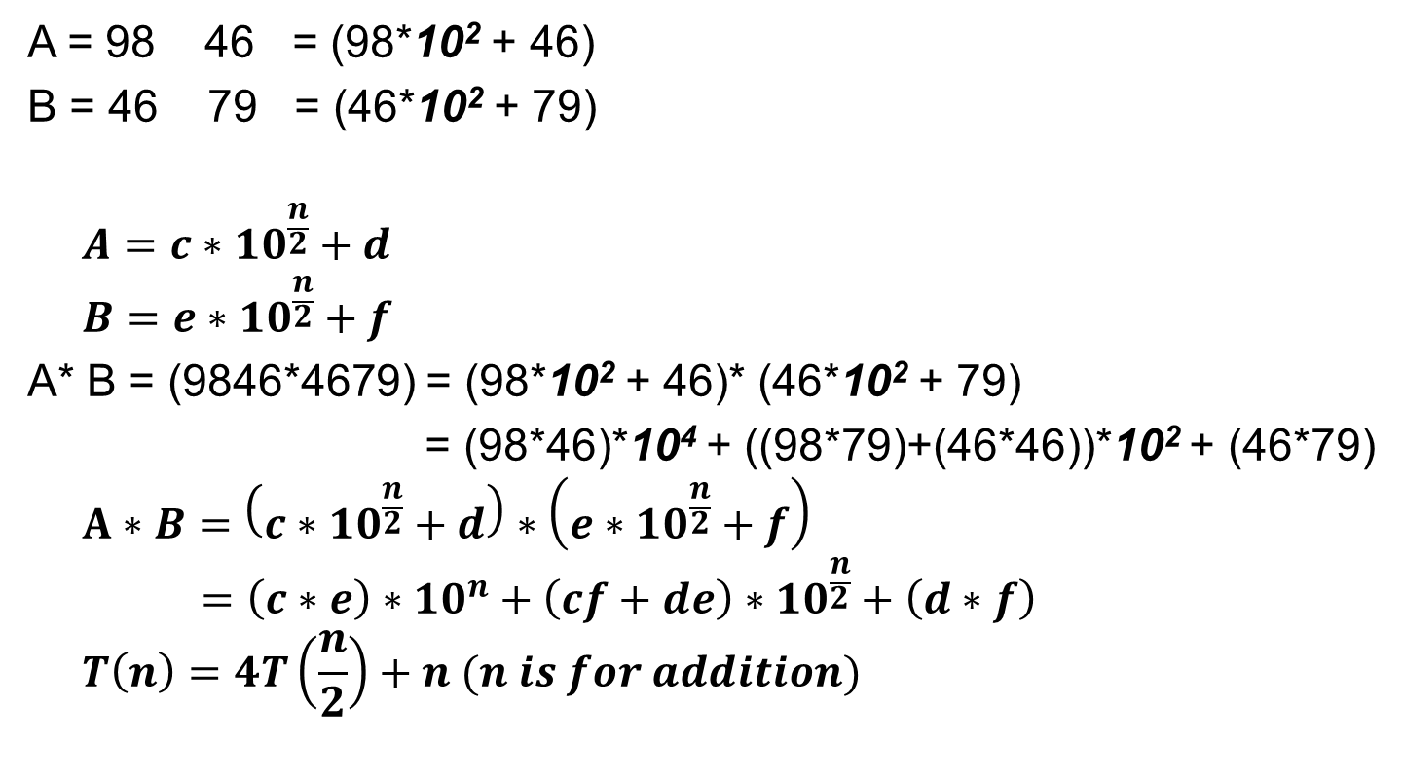
Decimal Number multiplication (D&C)
c
n = 4
d
A = 98 46 = (98*10² + 46)
B = 46 79 = (46*10² + 79)
$$A=c∗{10}^{\frac{n}{2}}+d$$
$$B=e∗{10}^{\frac{n}{2}}+f$$
A* B = (9846*4679) = (98*10² + 46)* (46*10² + 79)
= (98*46)*10⁴ + ((98*79)+(46*46))*10² + (46*79)
$$A∗B=\left(c∗{10}^{\frac{n}{2}}+d\right)∗\left(e∗{10}^{\frac{n}{2}}+f\right)$$
$$=\left(c∗e\right)∗{10}^{n}+\left(cf+de\right)∗{10}^{\frac{n}{2}}+\left(d∗f\right)$$
$$T\left(n\right)=4T\left(\frac{n}{2}\right)+n (n is for addition)$$
e
f

Slide 20
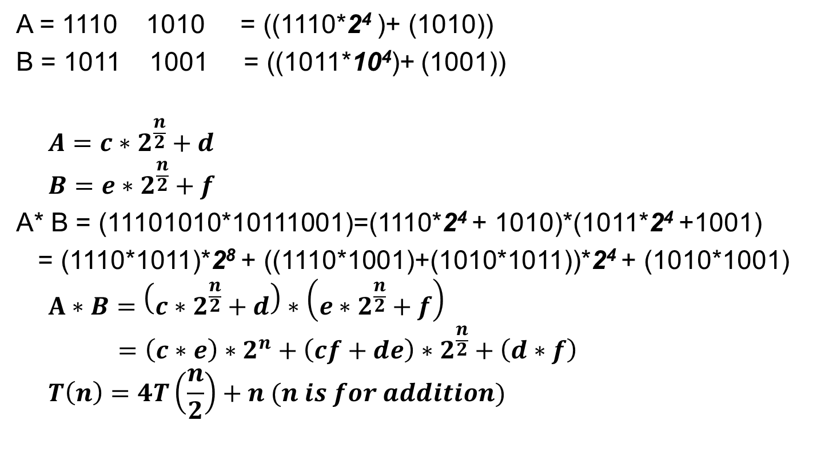
Binary Number multiplication (D&C)
c
n = 8
d
A = 1110 1010 = ((1110*2⁴ )+ (1010))
B = 1011 1001 = ((1011*10⁴)+ (1001))
$$A=c∗2^{\frac{n}{2}}+d$$
$$B=e∗2^{\frac{n}{2}}+f$$
A* B = (11101010*10111001)=(1110*2⁴ + 1010)*(1011*2⁴ +1001)
= (1110*1011)*2⁸ + ((1110*1001)+(1010*1011))*2⁴ + (1010*1001)
$$A∗B=\left(c∗2^{\frac{n}{2}}+d\right)∗\left(e∗2^{\frac{n}{2}}+f\right)$$
$$=\left(c∗e\right)∗2^{n}+\left(cf+de\right)∗2^{\frac{n}{2}}+\left(d∗f\right)$$
$$T\left(n\right)=4T\left(\frac{n}{2}\right)+n (n is for addition)$$
e
f

Slide 21
Binary Number multiplication (D&C)

Slide 22
Graphs

Slide 23
Graphs
Terms and Definitions:
Nodes, Edges, Labeling, Weights, Paths…
Representation & Storage
Edge List,
Adjacency list,
Adjacency Matrix
Graph Traversals
BFS
DFS

Slide 24
Graphs
Tree
Binary Tree
Spanning Tree
Minimum Spanning Tree
Shortest Path

Slide 25
Greedy Algorithms

Slide 26
Plan of Lecture
Introduction to Greedy Algorithms.
Some simple examples for Greedy Algorithms.
Activity Selection.
Knapsack Problem.
Shortest Path Algorithms.
Part of graph algorithm module.

Slide 27
Greedy Method
Solve problem by making a sequence of decisions.
Decisions are made one by one in some order.
Each decision is made using a greedy criterion.
A decision, once made, is (usually) not changed later.

Slide 28
Greedy Method
Greedy Algorithm Types
Non-adaptive: Fix some ordering of decisions a priori and stick with the order
Adaptive: make decisions adaptively but greedily/locally at each step
The problem must have the optimal substructure property: “the optimal solution to the problem contains within it optimal solutions to smaller subproblems.”
A simpler and often less powerful (and less well-defined), technique that uses the same feature of optimal substructure is greediness.

Slide 29
knapsack problem
0 − 1 knapsack problem:
Given n items, with item i being worth ₹ v_{i} and having weight w_{i}, Kg fill knapsack of capacity w Kg with maximal value.
N items (can be the same or different)
Have only one of each
Must leave or take (ie 0 -1) each item
DP works, greedy does not
Fractional knapsack problem:
As 0−1 knapsack problem but we can take fractions of items.
N items (can be the same or different)
Can take fractional part of each item (eg bags of gold dust)
Greedy works and DP algorithms work

Slide 30
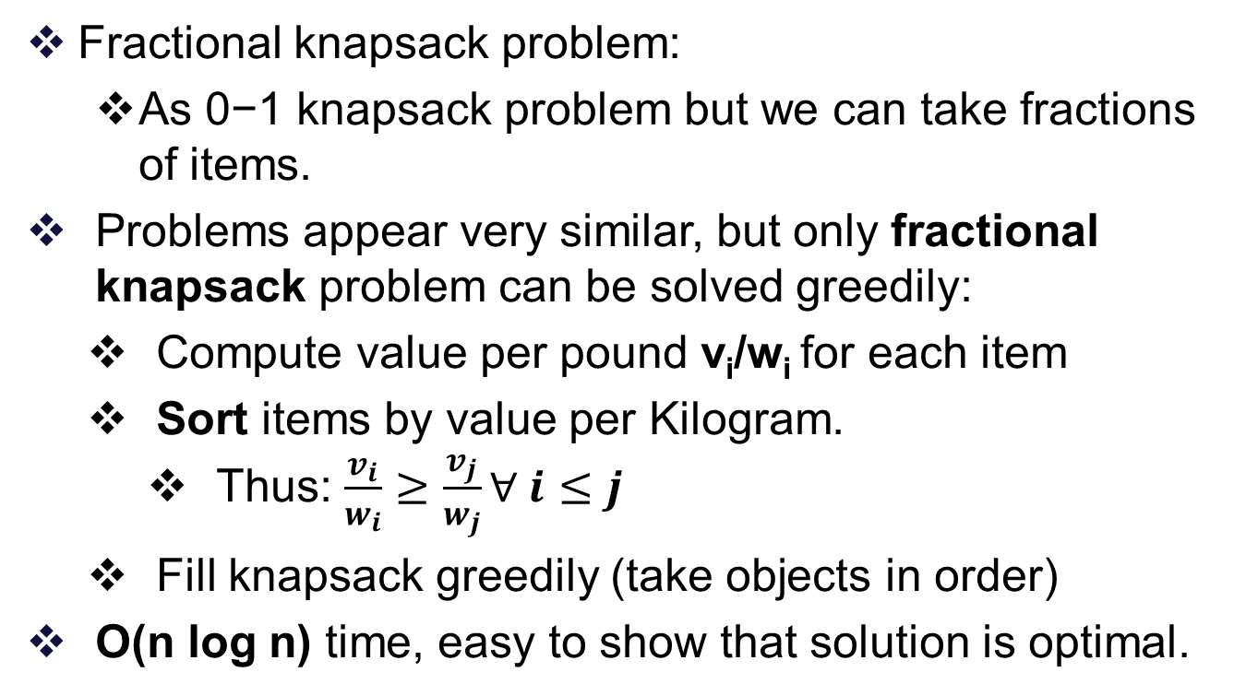
knapsack problem
Fractional knapsack problem:
As 0−1 knapsack problem but we can take fractions of items.
Problems appear very similar, but only fractional knapsack problem can be solved greedily:
Compute value per pound v_{i}/w_{i} for each item
Sort items by value per Kilogram.
Thus: $\frac{v_{i}}{w_{i}}≥\frac{v_{j}}{w_{j}}∀ i≤j$
Fill knapsack greedily (take objects in order)
O(n log n) time, easy to show that solution is optimal.

Slide 31
Example: (knapsack problem)
Example that 0 − 1 knapsack problem cannot be solved greedily:
Note: In fractional knapsack problem we can take 2/3 of ₹ 120 object and get ₹ 240 solution.
0 − 1 knapsack problem can be solved in time O(n * w) using dynamic-programming.

Slide 32
knapsack problem
‐‐ Assumes value and weight arrays are sorted by v_{i} / w_{i}
Fractional‐Knapsack(v, w, W)
load := 0
i := 1
while load < W and i ≤ n loop
if w_{i} ≤ W ‐ load then
take all of item i
else
take (W‐load) / w_{i} of item i
end if
add weight of what was taken to load
i := i + 1
end loop
return load

Slide 33
Example: (knapsack problem)
Example: Knapsack Capacity W = 30 and
Solution:
All of A, all of B, and ((30-25)/ 10) of C (and none of D)
Size: 5 + 20 + 10*(5/10) = 30
Value: 50 + 140 + 60*(5/10) = 190 + 30 = 220
Time: Θ(n), if already sorted
Item | A | B | C | D
Price | 50 | 140 | 60 | 60
Size | 5 | 20 | 10 | 12
Ratio | 10 | 7 | 6 | 5

Slide 34
Example: (knapsack problem)
Greedy doesn't work for 0-1 Knapsack Problem:
Example: Knapsack Capacity W = 25 and
Optimal: B and C. Size=10+10=20. Price=9+9=18
Possible greedy approach: take largest Price first (Price=12, not optimal)
Possible greedy approach: take smallest size item first (Price=9+5=14, not optimal)
Item | A | B | C | D
Price | 12 | 9 | 9 | 5
Size | 24 | 10 | 10 | 7

Slide 35
Example: (knapsack problem)
Greedy doesn't work for 0-1 Knapsack Problem:
Example: Knapsack Capacity W = 30 and
Possible greedy approach: take largest ratio: (Solution: A and B. Size=5+20=25. Price=50+140=190
Optimal: B and C. Size=20+10=30. Price=140+60=200
Greedy fractional: A, B, and half of C. Size=5+20+10*(5/10)=30. Price 50+140+60* (5/10) = 190+30 = 220
Item | A | B | C
Price | 50 | 140 | 60
Size | 5 | 20 | 10
Ratio | 10 | 7 | 6

Slide 36
Pros and Cons of Greedy Algorithms
Pros:
Usually (too) easy to design greedy algorithms
Easy to implement and often run fast since they are simple
Several important cases where they are elective/optimal
Cons:
Very often greedy algorithms don't work. Easy to lull oneself into believing they work
Many greedy algorithms possible for a problem and no structured way to find effective ones
Every greedy algorithm needs a proof of correctness

Slide 37
Activity Selection
Problem: Given a set A = {A₁,A₂, · · · ,A_{n}} of n activities with start and finish times (s_{i}, f_{i}), 1 <= i <= n, select maximal set S of “non-overlapping” activities.
One can think of the problem as corresponding to scheduling the maximal number of classes (given their start and finish times) in one classroom.
Dynamic programming solution: O(n³); read the textbook.

Slide 38
Activity Selection
Problem: Given a set A = {A₁,A₂, · · · ,A_{n}} of n activities with start and finish times (s_{i}, f_{i}), 1 <= i <= n, select maximal set S of “non-overlapping” activities.
Greedy solution:
Sort activity by finish time (A₁,A₂, · · · ,A_{n} denote sorted sequence)
Pick first activity A₁
Remove all activities with start time before finish time of A₁
Recursively solve problem on remaining activities.

Slide 39
Activity Selection
Problem: Given a set A = {A₁,A₂, · · · ,A_{n}} of n activities with start and finish times (s_{i}, f_{i}), 1 <= i <= n, select maximal set S of “non-overlapping” activities.
Program:
Sort A by finish time
S = {A₁}
j = 1
FOR i = 2 to n DO {
IF s_{i} s_{j} THEN {
S = S [ {Ai}
j = I }}

Slide 40
Activity Selection Example
11 activities sorted by finish time: (1, 4), (3, 5), (0, 6), (5, 7), (3, 8), (5, 9), (6, 10), (8, 11), (8, 12), (2, 13), (12, 14)

Slide 42
Activity Selection Example
Example:
11 activities sorted by finish time: (1, 4), (3, 5), (0, 6), (5, 7), (3, 8), (5, 9), (6, 10), (8, 11), (8, 12), (2, 13), (12, 14)
Running time is obviously O(n log n).
Is algorithm correct?
Output is set of non-overlapping activities, but is it the largest possible?
Proof of correctness: view Recorded Lecture.

Slide 43
Comparison of greedy technique with dynamic programming
Both techniques use optimal substructure (“optimal solution contains optimal solution for subproblems within it”).
In dynamic programming, solution depends on solution to subproblems. i.e., compute the optimal solutions for each possible choice and then compute the optimal way to combine things together.
Any problem that can be solved by a greedy algorithm can be solved by dynamic programming, but not the other way around.
In greedy algorithm we choose what looks like best solution at any given moment and recurse (choice does not depend on solution to subproblems).
Note: Short sightedness: Always go for seemingly next best thing, optimizing the present without regard for the future, and never change past choices.

Slide 44
Comparison of greedy technique with dynamic programming
It is often hard to figure out when being greedy works!
How do we know if being greedy works? Try dynamic programming first and understand the choices. Try to find out if there is a locally best choice, i.e. a choice that looks better than the others (without computing recursive solutions to subproblems). Now try to prove that it works correctly.
Greedy correctness proof: It is enough to prove that there exists an optimal solution which contains the greedy choice. i.e., prove that, having made the greedy choice, what remains is a subproblem with the property that if we combine the optimal solution to the subproblem with the greedy choice, we get an optimal solution for the original problem. Typically this is proved by contradiction.

Slide 45
Graph Algorithms
Minimum Spanning Tree

Slide 46
Edge Selection Greedy Strategies
Start with a 1-vertex tree and grow it into an n-vertex tree by repeatedly adding a vertex and an edge. When there is a choice, add a least cost edge.
Prim’s method.
Start with an n-vertex 0-edge forest. Consider edges in ascending order of cost. Select edge if it does not form a cycle together with already selected edges.
Kruskal’s method.

Slide 47
Kruskal’s Method
8
10
14
1
3
5
7
Start with a forest that has no edges.
1
3
5
7
7
4
12
6
3
2
2
4
6
8
2
4
6
8
9
Consider edges in ascending order of cost.
Edge (1,2) is considered first and added to the forest.

Slide 48
Kruskal’s Method
8
10
14
1
3
5
7
Edge (7,8) is considered next and added.
1
3
5
7
7
3
7
4
6
3
2
4
12
6
2
2
4
6
8
2
4
6
8
9
Edge (3,4) is considered next and added.
Edge (5,6) is considered next and added.
Edge (2,3) is considered next and added.
Edge (1,3) is considered next and rejected because it creates a cycle.

Slide 49
Kruskal’s Method
8
10
14
10
14
1
3
5
7
Edge (2,4) is considered next and rejected because it creates a cycle.
1
3
5
7
7
3
7
4
6
3
2
4
12
6
2
2
4
6
8
2
4
6
8
9
Edge (3,5) is considered next and added.
Edge (3,6) is considered next and rejected.
Edge (5,7) is considered next and added.

Slide 50
Kruskal’s Method
8
10
14
10
14
1
3
5
7
n - 1 edges have been selected and no cycle formed.
So we must have a spanning tree.
Cost is 46.
Min-cost spanning tree is unique when all edge costs are different.
1
3
5
7
7
3
7
4
6
3
2
4
12
6
2
2
4
6
8
2
4
6
8
9

Slide 51
Kruskal’s Method (detection of cycle)
8
10
14
10
14
1
3
5
7
As the Tree starts from a forest
Contains a cycle if both the end points lies in same sub tree.
1
3
5
7
7
3
7
4
6
3
2
4
12
6
2
2
4
6
8
2
4
6
8
9

Slide 52
Prim’s Method
8
10
14
10
14
1
3
5
7
Start with any single vertex tree.
1
3
5
7
7
3
7
4
6
3
2
4
12
6
2
2
4
6
8
2
4
6
8
9
Get a 2-vertex tree by adding a cheapest edge.
Get a 3-vertex tree by adding a cheapest edge.
Grow the tree one edge at a time until the tree has n - 1 edges (and hence has all n vertices).

Slide 53
Prim’s Method (detection of cycle)
8
10
14
10
14
1
3
5
7
Initialize the array of size n (number of nodes) as untraversed
Select an edge,
if both of its end points are traversed, it create a cycle, discard it.
Else Mark it traversed, and add it into the growing tree.
1
3
5
7
7
3
7
4
6
3
2
4
12
6
2
2
4
6
8
2
4
6
8
9

Slide 54
Prim’s Algorithm
MST-Prim(G, w, r)
Q = V[G];
for each u ∈ Q
key[u] = ∞;
key[r] = 0;
p[r] = NULL;
while (Q not empty)
u = ExtractMin(Q);
for each v ∈ Adj[u]
if (v ∈ Q and w(u,v) < key[v])
p[v] = u;
key[v] = w(u,v);
Grow a single tree by repeatedly adding the least cost edge that connects a vertex in the existing tree to a vertex not in the existing tree
Intermediary solution is a subtree

Slide 55
Prim’s Algorithm
6
4
MST-Prim(G, w, r)
Q = V[G];
for each u ∈ Q
key[u] = ∞;
key[r] = 0;
p[r] = NULL;
while (Q not empty)
u = ExtractMin(Q);
for each v ∈ Adj[u]
if (v ∈ Q and w(u,v) < key[v])
p[v] = u;
key[v] = w(u,v);
5
9
14
2
10
15
3
8
Run on example graph

Slide 56
Kruskal’s Algorithm
Kruskal()
{
T = ∅;
for each v ∈ V
MakeSet(v);
sort E by increasing edge weight w
for each (u,v) ∈ E (in sorted order)
if FindSet(u) ≠ FindSet(v)
T = T U {{u,v}};
Union(FindSet(u), FindSet(v));
}
Grow a tree by repeatedly adding the least cost edge that does not introduce a cycle among the edges included so far
Intermediary solution is a spanning forest

Slide 57
Kruskal’s Algorithm
Run the algorithm:
2
19
Kruskal()
{
T = ∅;
for each v ∈ V
MakeSet(v);
sort E by increasing edge weight w
for each (u,v) ∈ E (in sorted order)
if FindSet(u) ≠ FindSet(v)
T = T U {{u,v}};
Union(FindSet(u), FindSet(v));
}
9
14
17
8
25
5
21
13
1

Slide 58
Shortest Path Problems
Directed weighted graph.
Path length is sum of weights of edges on path.
The vertex at which the path begins is the source vertex.
The vertex at which the path ends is the destination vertex.

Slide 59
Example
8
6
A path from 1 to 7.
2
1
1
3
3
16
1
6
7
4
5
10
4
2
4
7
7
5
3
14
Path length is 14.

Slide 60
Example
8
6
Another path from 1 to 7.
2
1
3
3
16
1
6
7
4
5
10
4
2
4
7
5
3
14
Path length is 11.

Slide 61
Shortest Path Problems
Single source single destination.
Single source all destinations.
All pairs (every vertex is a source and destination).

Slide 62
Single Source Single Destination
Possible greedy algorithm:
Leave source vertex using cheapest/shortest edge.
Leave new vertex using cheapest edge subject to the constraint that a new vertex is reached.
Continue until destination is reached.

Slide 63
Greedy Shortest 1 To 7 Path
8
6
2
1
3
3
16
1
6
7
4
5
10
4
2
4
7
5
3
14
Path length is 12.
Not shortest path. Algorithm doesn’t work!

Slide 64
Single Source All Destinations
Need to generate up to n (n is number of vertices) paths (including path from source to itself).
Greedy method:
Construct these up to n paths in order of increasing length.
Assume edge costs (lengths) are >= 0.
So, no path has length < 0.
First shortest path is from the source vertex to itself. The length of this path is 0.
Notes:
The solution to the problem consists of up to n paths. The greedy method suggests building these n paths in order of increasing length. First build the shortest of the up to n paths (I.e., the path to the nearest destination). Then build the second shortest path, and so on.

Slide 65
Greedy Single Source All Destinations
2
8
6
1
3
3
16
1
6
7
4
5
10
4
2
4
7
5
3
14
Path
Length
6
1
2
1
0
1
3
5
4
9
1
3
2
1
3
6
10
1
3
5
5
1
3
6
7
11

Slide 66
Greedy Single Source All Destinations
Path
Length
1
0
Each path (other than first) is a one edge extension of a previous path.
Next shortest path is the shortest one edge extension of an already generated shortest path.
1
3
2
1
3
5
5
1
2
6
1
3
5
4
9
1
3
6
10
1
3
6
7
11

Slide 67
Greedy Single Source All Destinations
Let d(i) (distanceFromSource(i)) be the length of a shortest one edge extension of an already generated shortest path, the one edge extension ends at vertex i.
The next shortest path is to an as yet unreached vertex for which the d() value is least.
Let p(i) (predecessor(i)) be the vertex just before vertex i on the shortest one edge extension to i.

Slide 68
Greedy Single Source All Destinations
2
8
6
1
3
3
3
16
1
6
7
4
5
10
4
2
2
4
4
7
7
5
3
1
14
[1]
[2]
[3]
[4]
[5]
[6]
[7]
d
0
6
2
2
16
-
-
14
p
-
1
1
1
-
-
1

Slide 69
Greedy Single Source All Destinations
6
2
8
6
1
3
3
16
1
7
5
6
4
5
10
4
2
2
4
7
5
3
1
14
1
3
[1]
[2]
[3]
[4]
[5]
[6]
[7]
d
0
6
2
16
5
-
-
14
5
10
p
-
1
1
1
-
-
1
3
3

Slide 70
Greedy Single Source All Destinations
2
8
6
1
3
3
16
1
6
7
4
5
10
4
2
4
4
7
7
5
3
1
14
1
3
[1]
[2]
[3]
[4]
[5]
[6]
[7]
d
0
6
2
16
-
-
14
1
3
5
6
9
5
10
p
-
1
1
1
-
-
1
5
3
3

Slide 71
Greedy Single Source All Destinations
2
8
6
1
3
3
16
1
6
7
4
5
10
4
2
4
4
7
5
3
1
14
1
3
[1]
[2]
[3]
[4]
[5]
[6]
[7]
d
0
6
2
9
-
-
14
1
3
5
9
5
10
p
-
1
1
5
-
-
1
3
3
1
2

Slide 72
Greedy Single Source All Destinations
2
8
6
1
3
3
16
1
6
7
4
5
10
4
2
4
7
7
5
3
1
14
1
3
[1]
[2]
[3]
[4]
[5]
[6]
[7]
10
d
0
6
2
9
-
10
14
1
3
5
5
12
p
-
1
1
5
-
-
1
3
3
4
1
2
1
3
5
4

Slide 73
Greedy Single Source All Destinations
2
8
6
1
3
3
16
1
6
7
4
5
10
4
2
4
7
7
5
3
14
1
3
6
[1]
[2]
[3]
[4]
[5]
[6]
[7]
d
0
6
2
9
5
11
-
10
-
14
12
p
-
1
1
5
3
-
3
-
4
1
6

Slide 74
Greedy Single Source All Destinations
Path
Length
1
0
1
3
2
1
3
5
5
1
2
6
[1]
[2]
[3]
[4]
[5]
[6]
[7]
1
3
5
4
9
0
6
2
9
5
-
10
-
14
12
11
-
1
1
5
3
-
-
3
4
1
10
6
1
3
6
1
3
6
7
11
Notes:
Can construct shortest paths from the computed p[] data.

Slide 75
Single Source Single Destination
Terminate single source all destinations greedy algorithm as soon as shortest path to desired vertex has been generated.

Slide 76
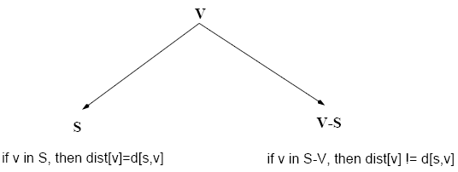
Dijkstra’s Algorithm
Single-source shortest path problem:
No negative-weight edges: w(u, v) > 0 ∀ (u, v) ∈ E
Each edge is relaxed only once!
Maintains two sets of vertices:
d[v]=δ (s, v)
d[v]>δ (s, v)

Slide 77
Data Structures For Dijkstra’s Algorithm
The greedy single source all destinations algorithm is known as Dijkstra’s algorithm.
Implement d() and p() as 1D arrays.
Keep a linear list L of reachable vertices to which shortest path is yet to be generated.
Select and remove vertex v in L that has smallest d() value.
Update d() and p() values of vertices adjacent to v.

Slide 78
Complexity
O(n) to select next destination vertex.
O(out-degree) to update d() and p() values when adjacency lists are used.
O(n) to update d() and p() values when adjacency matrix is used.
Selection and update done once for each vertex to which a shortest path is found.
Total time is O(n² + e) = O(n²).

Slide 79
Complexity
When a min heap of d() values is used in place of the linear list L of reachable vertices, total time is O((n+e) log n), because O(n) remove min operations and O(e) change key (d() value) operations are done.
When e is O(n²), using a min heap is worse than using a linear list.
When a Fibonacci heap is used, the total time is O(nlogn+e).

Slide 80
Bellman-Ford Algorithm (cont’d)
Idea:
Each edge is relaxed |V – 1| times by making |V-1| passes over the whole edge set.
To make sure that each edge is relaxed exactly |V – 1| times, it puts the edges in an unordered list and goes over the list |V – 1| times.
(t, x), (t, y), (t, z), (x, t), (y, x), (y, z), (z, x), (z, s), (s, t), (s, y)
t
5
x
∞
∞
6
-2
-3
s
0
8
7
-4
7
2
∞
∞
9
y
z

Slide 81
Thank You

